Slide 1
MINI PROJECT - 1
Vocabulary Tutor
Guide : Mrs. KAMALA
Batch - 92
19H51A05P0 - MOIN ASHIQ
19H51A05N8 - M . MOUNIKA
19H51A05N6 - K. JAI SANTOSH BABU

Slide 2
CONTENTS:
ABSTRACT
PROBLEM STATEMENT
INTRODUCTION
LITERATURE REVIEW
MOTIVATION BEHIND SELECTION OF PROJECT
PROPOSED SOLUTION
OBJECTIVES
HARDWARE AND SOFTWARE REQUIREMENTS
UML DIAGRAMS
RESULT & CONCLUSION
REFERENCES

Slide 3

ABSTRACT
The aim of the project is to develop English Vocabulary of users. This project allows the user to set timer and after specified time a popup will appear at desktop notification showing an English word and its meaning. If the timer is set to one hour then after every one hour an English word and the meaning of the word will pop-up at desktop notification.
In this way while working on Desktop or laptops one can open
this application and set the timer so that they can learn new
words and their meaning.

Slide 4
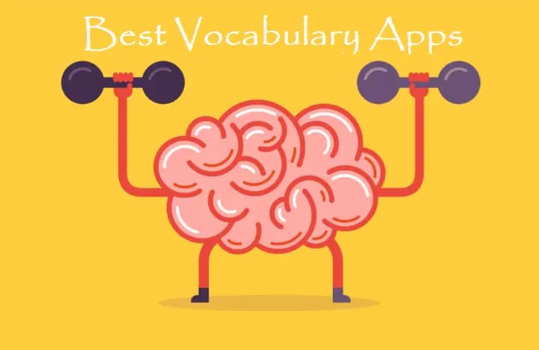
PROBLEM STATEMENT
Develop an application which helps in learning new vocabulary.

Slide 5
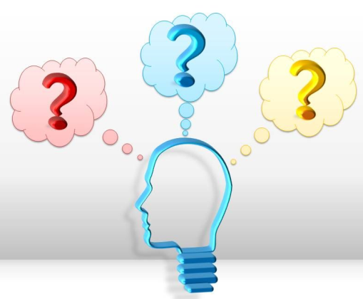
INTRODUCTION
English language plays an essential role in our lives as it helps in communications. It is the main language for studying any subject all over the world. English is important for students as it broadness their minds, develops emotional skills, improve the quality of life by providing job opportunities.
Why vocabulary is important?
Learners can express themselves better.
Knowing more words allows a learner to choose their words more precisely and so become more effective and accurate when communicating with others.
It empowers learners academically.
Students need vocabulary instruction that allow them to build rich representation of words.

Slide 6

LITERATURE REVIEW :- (EXISTING SYSTEMS)
Paper -1 :
Using Realia to Improve English Vocabulary
(Realia is one of the aid that can be used in teaching English Vocabulary at primary level. To provide students interest and involvement in the subject with the help of realia.
Author : Faisal Irfan, Tajammal Hussain Awan, Tayyaba Bashir, Hazhar Ramadhan Ahmed
Issue Year: March 30, 2021
Demerits:
Not a dynamic app.
This app is applicable only for :- Primary School

Slide 7

Paper – 2:-
The Core Vocabulary
(It can be used in teaching English Vocabulary at secondary level. The basis for selecting six to eight words for a week of vocabulary. )
Author : Elfrieda H. Hiebert
Issue Year: 1989
Demerits:
Not a dynamic app.
It is applicable only in androids.
This app is applicable only for :- Secondary school students.
Access Internet

Slide 8
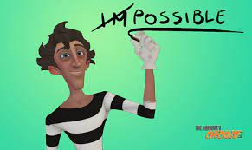
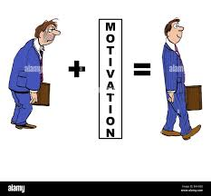
MOTIVATION BEHIND SELECTION OF PROJECT:
The main motivation for selecting this project is particularly useful to develop our Vocabulary skills. As we know English is an important language to communicate with the people from different states, countries, etc., it is important to use good vocabulary to express ourselves. And in the busy life many people don’t get time to focus on development of their vocabulary. So we developed this application, which is helpful to learn new words every day.
Now a days many of us work on desktop, laptops. So, while working on them we can switch to this application and can set timer. After every specified time it will notify with an English word and it’s meaning. In this way user can learn new words every day and can implement the while communicating with others which will be very helpful.

Slide 9

PROPOSED SOLUTION
This project allows the user to set timer and after specified time a popup will appear at desktop notification showing and English word and its meaning. If the timer is set to one hour then after every one hour an English word and the meaning of the word will pop-up at desktop notification.
In this way while working on Desktop or laptops one can open this application and set the timer so that they can learn new words and their meaning.

Slide 10
OBJECTIVES
Dynamic model.
It doesn’t access internet.
It can be useful for everyone.
Timer can be specified by user.
Voice module is also helpful.
Infinite number of words can be learned daily without any limitations & no repeated words.

Slide 11
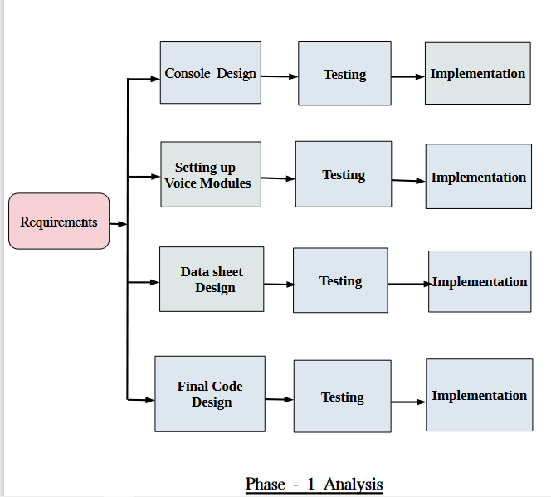
Analysis

Slide 12

HARDWARE REQUIREMENTS & SOFTWARE REQUIREMENTS
HARWARE REQUIREMENTS: Desktop or laptop.
SOFTWARE REQUIREMENTS:
We used python & its libraries and MS Excel to develop this project.
Required installation modules:
➢ tkinter
➢ pyttsx3
➢ plyer
➢ openpyxl
➢ inflect

Slide 13
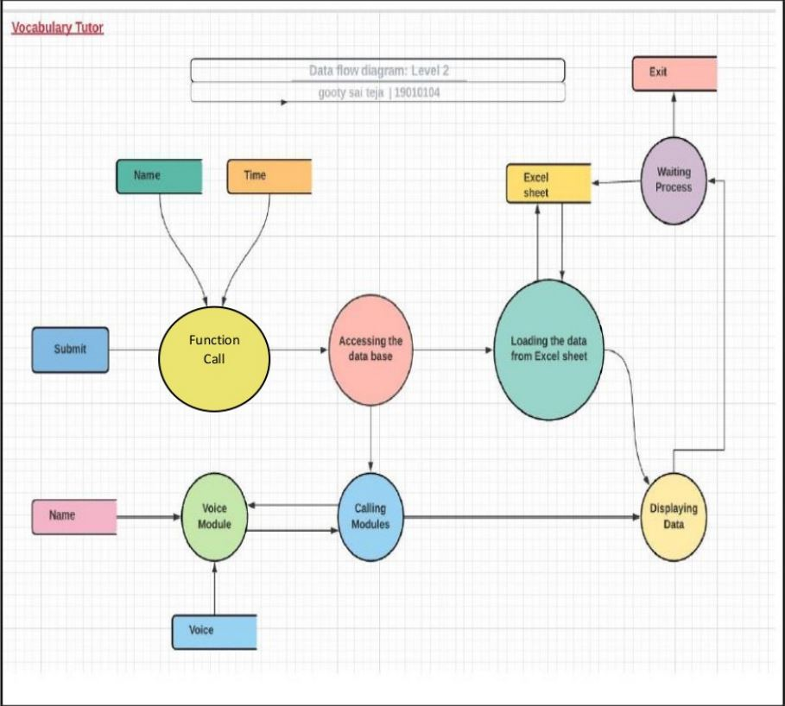
DATA FLOW CONTROL DIAGRAM

Slide 14
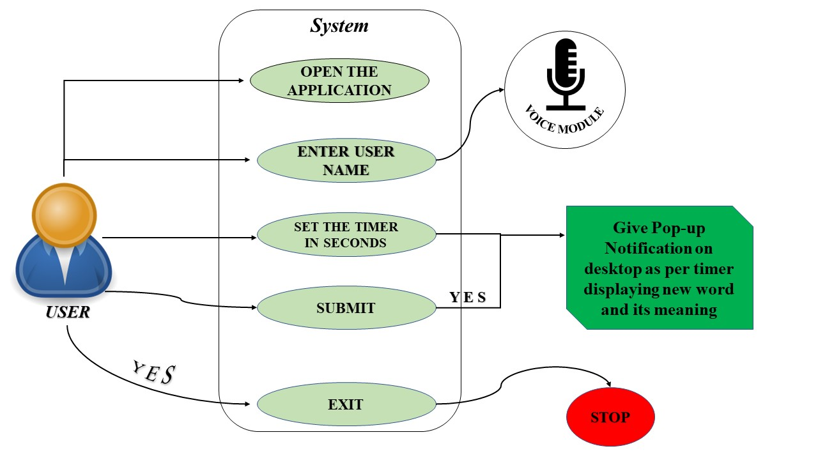
USE CASE DIAGRAM

Slide 15
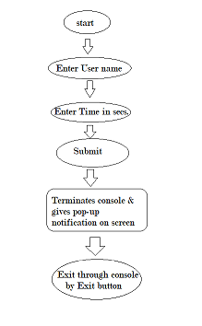
ACTIVITY DIAGRAM
UML Diagram

Slide 16
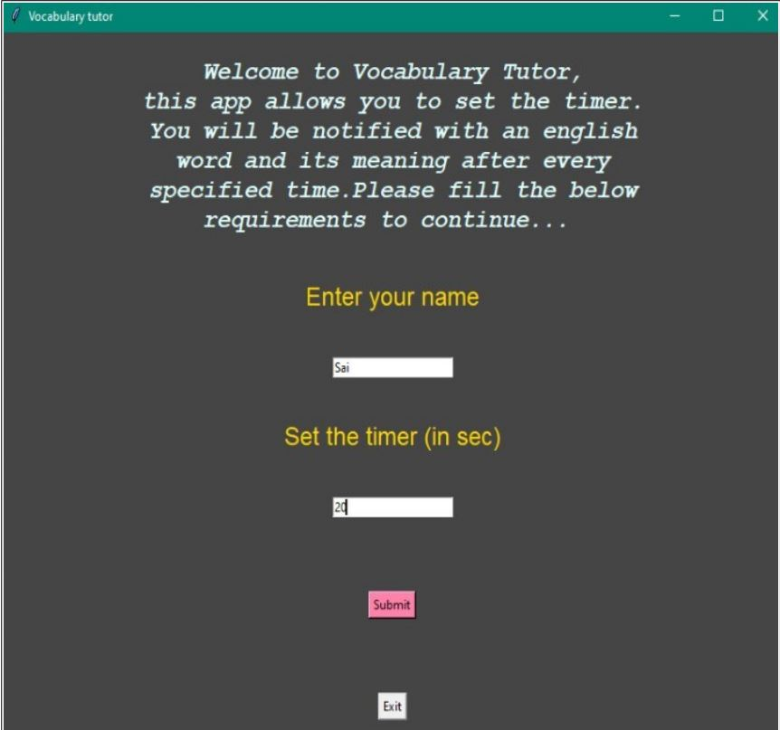
RESULT
1. When the executable is run on any system it displays a GUI console which takes two inputs name and timer as shown.

Slide 17
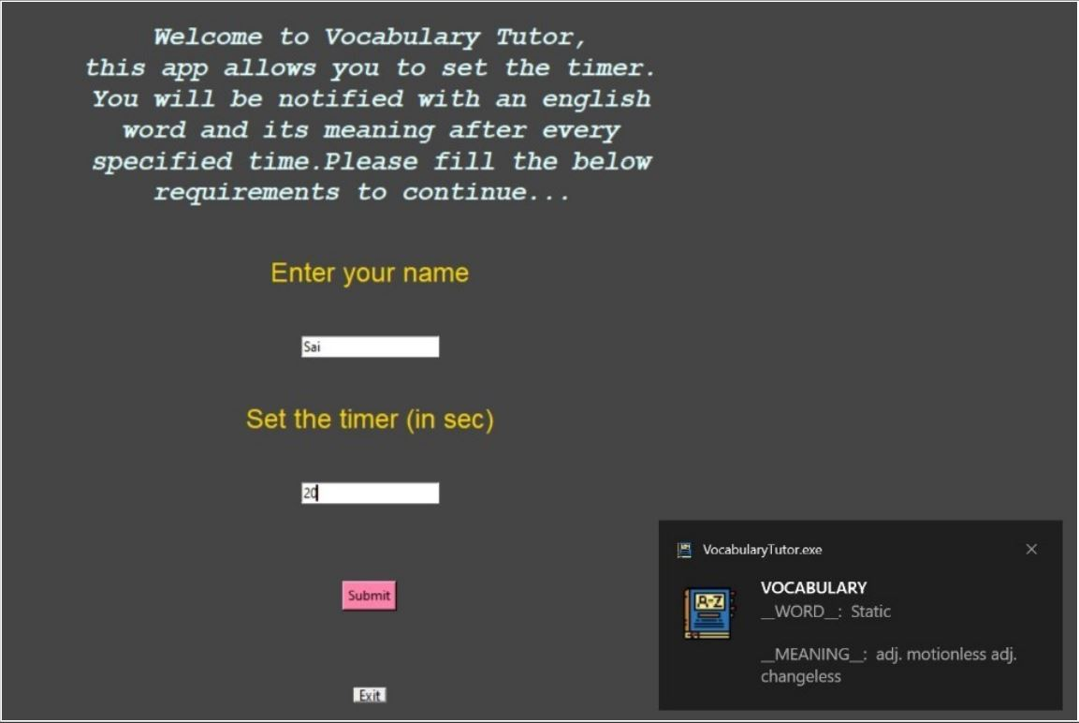
RESULT
2.After clicking submit button it will displays notification with an English word and its meaning then it will wait for specified time and then again notification will be displayed with another word and its meaning as shown.

Slide 18
CONCLUSION
The Vocabulary Tutor application works as a remainder which displays a new word and its meaning after every specified time by the user. As many people now a days are using laptops, mobile phones, etc.. This application will be especially useful in Developing the vocabulary of the users.

Slide 19
FutureWork
As this application was made only for Desktops, laptops will try to develop the similar application which will be available for android users as well. And also will try to add new features and better vocabulary as well.
REFERENCES
https://github.com/gst1919/Vocabulary-Tutor.git
https://www.tutorialspoint.com/python/
https://pypi.org/project/pyinstaller/
https://drive.google.com/file/d/1E69J1Jh25Od1ZuR90C3ZWgttOQZlRjZT/view?usp=sharing
https://www.researchgate.net/publication/350960189_Using_Realia_to_Improve_English_Vocabulary_at_Primary_Level
https://www.researchgate.net/publication/343252325_Effective_English_vocabulary_learning_strategies_A_research_summary

Slide 20

Thank you

